Slide 1
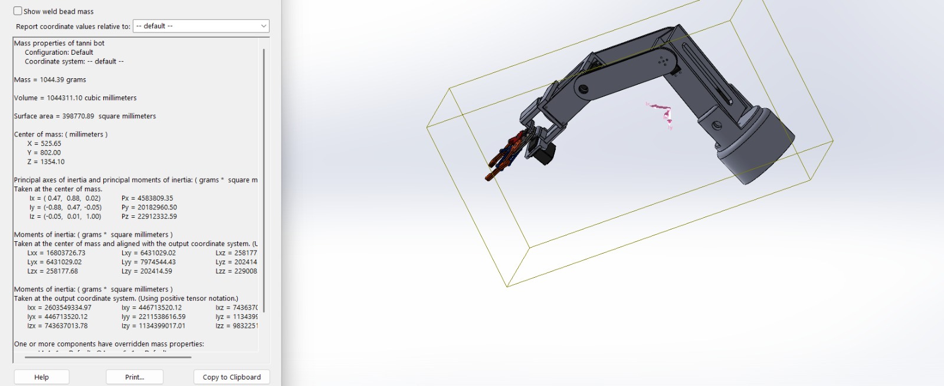
Robotic Arm
5-DOF Articulated Robotic Arm
1044 g
5 DOF
Total Mass
Degrees of Freedom
MG995
PUR
Servo Motors × 6
Print Material
Department of Mechanical Engineering | 2025–26

Slide 2
OVERVIEW
Presentation Outline
01
Introduction
06
FEA Analysis
Background & motivation for robotic arms
Structural simulation results
02
Problem Statement
07
Torque & Payload
Challenges addressed by Tanni Bot
Joint torque calculations
03
Objectives
08
Circuit Diagram
Goals and success criteria
Arduino UNO control system
04
Components Used
09
Output & Results
Hardware, electronics & software
Simulation & physical results
05
Mechanical Design
10
Applications
SolidWorks CAD & 3D-printed assembly
Real-world use cases

Slide 3
01 — INTRODUCTION
Introduction to Robotic Arms
What is a Robotic Arm?
A mechanical manipulator mimicking human arm motion, capable of precise positioning in 3D space through multiple joints.
Why Articulated?
Articulated arms with revolute joints offer maximum flexibility and workspace coverage, essential for pick-and-place, welding, and assembly.
5 Degrees of Freedom
Each DOF adds an independent axis of motion — enabling complex trajectories and orientations unreachable by simpler designs.
Project Context
Tanni Bot is a 3D-printed, servo-driven robotic arm designed and simulated entirely in SolidWorks, then validated through FEA.

Slide 4
02 — PROBLEM STATEMENT
Problem Statement
"How can we design and fabricate a low-cost, multi-DOF articulated robotic arm using 3D printing and off-the-shelf servo motors, validated through FEA and kinematic analysis?"
💰 High Cost of Commercial Arms
⚙️ Structural Integrity Under Load
Industrial arms cost ₹5–50 lakhs. Existing low-cost options lack rigidity and precision for education/research use.
Lightweight 3D-printed materials must withstand servo torques and payload without deformation or failure.
🔗 Complex Multi-Joint Coordination
📐 Geometric & Mass Accuracy
Coordinating 5 DOF with limited servo torque requires careful kinematic planning and torque-chain analysis.
CAD-to-print accuracy must be validated; mass and inertia properties need verification for dynamic performance.

Slide 5
03 — OBJECTIVES
Project Objectives
01
Design a 5-DOF articulated robotic arm in SolidWorks with full assembly, mate constraints, and mass properties verification.
04
Perform FEA (Finite Element Analysis) on critical links using SolidWorks Simulation to verify stress within limits.
02
Select appropriate MG995 servo motors based on torque requirements computed via static load analysis.
05
Develop Arduino UNO-based control system for coordinated multi-joint actuation via servo PWM signals.
03
3D-print structural links in PUR (Polyurethane) material and validate dimensional accuracy against CAD model.
06
Analyse payload capacity, joint torques, and safety factors across all operating configurations.

Slide 6
04 — COMPONENTS USED
Components Used
Microcontroller
Actuators
Structure
Arduino UNO (ATmega328P)
6 PWM output pins
5V / 3.3V regulated supply
6× MG995 Metal Gear Servo
Stall torque: 13 kg·cm @ 6V
Operating voltage: 4.8–7.2V
3D-Printed PUR links
Acrylic (LINK 1)
Stainless steel fasteners
Electronics
Software
Sensors / I/O
PCA9685 16-ch Servo Driver
6V / 5A DC Power Supply
Jumper wires & breadboard
SolidWorks 2024/2025
SolidWorks Simulation (FEA)
Arduino IDE
Potentiometer knobs (manual)
USB serial for Arduino
Servo feedback (optional)

Slide 7
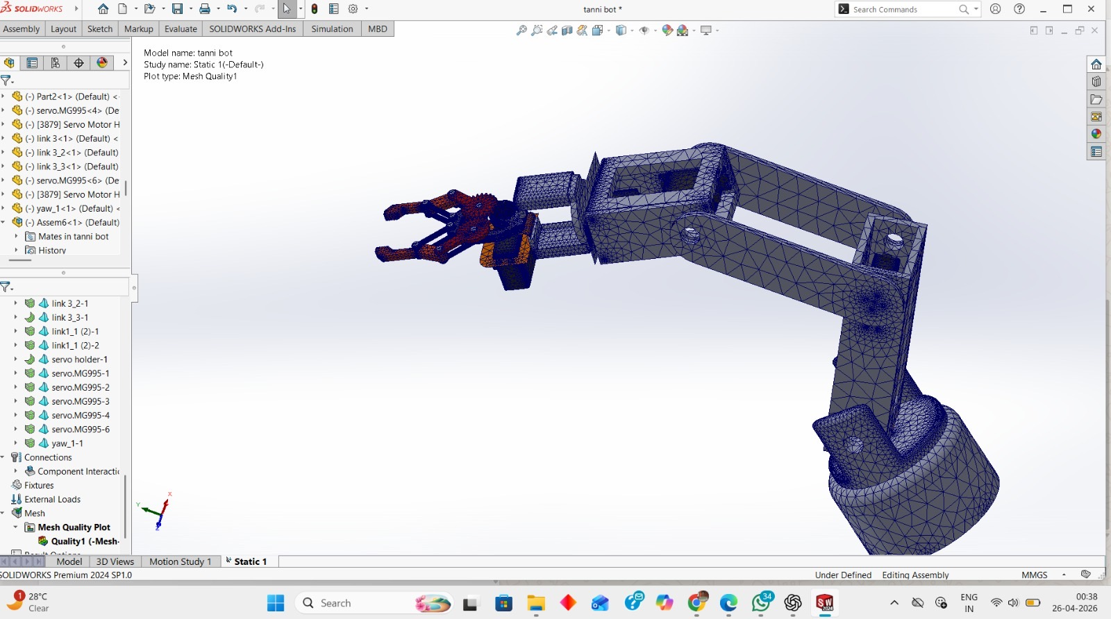
05 — MECHANICAL DESIGN
SolidWorks CAD — Full Assembly
Total Mass:
1044.39 g
Volume:
1,044,311 mm³
Surface Area:
398,771 mm²
CoM (X,Y,Z):
525, 802, 1354 mm
DOF:
5 (6 servos)
FEM Mesh Quality View (SolidWorks Simulation)

Slide 8
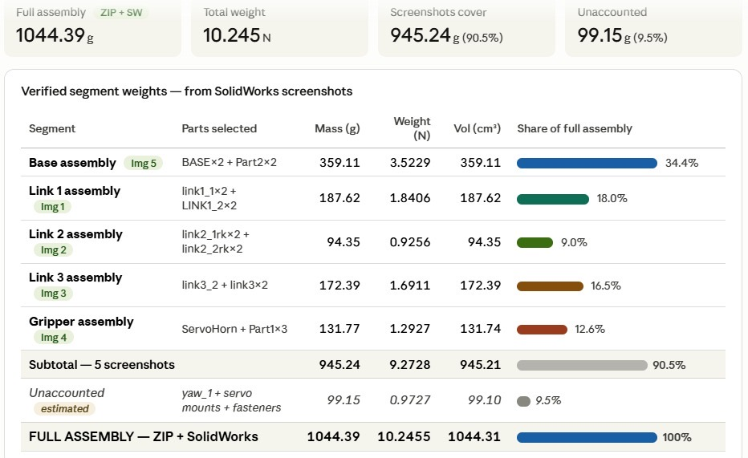
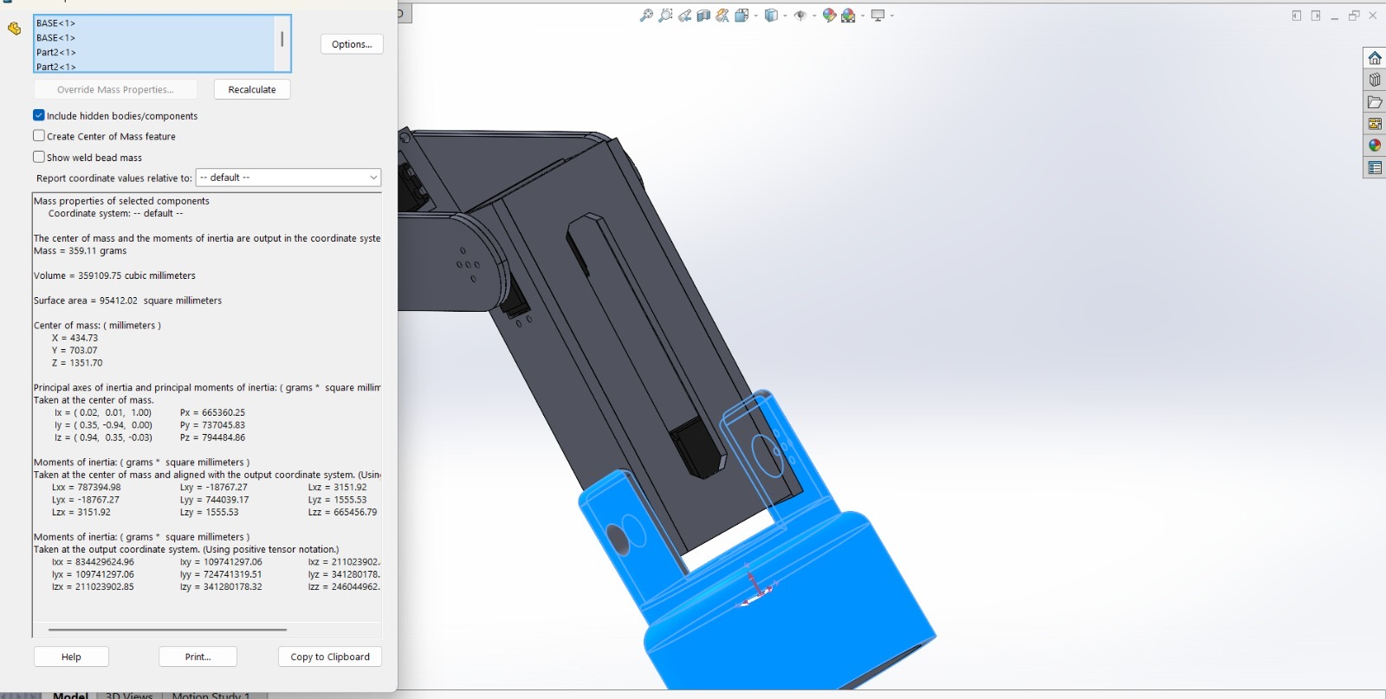
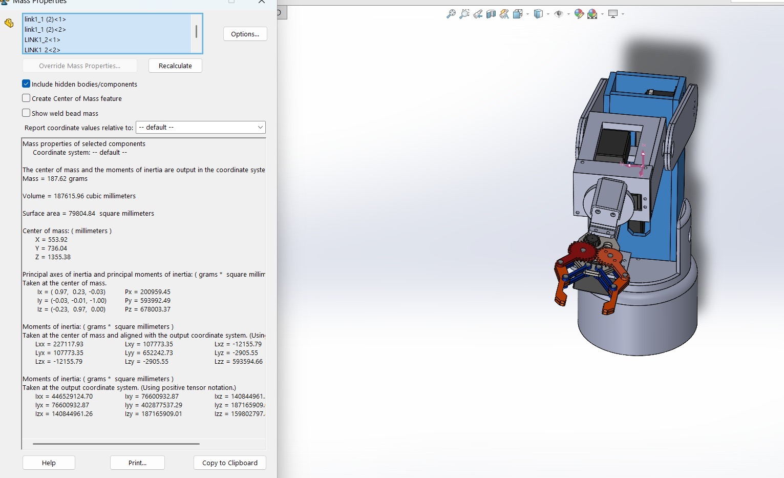
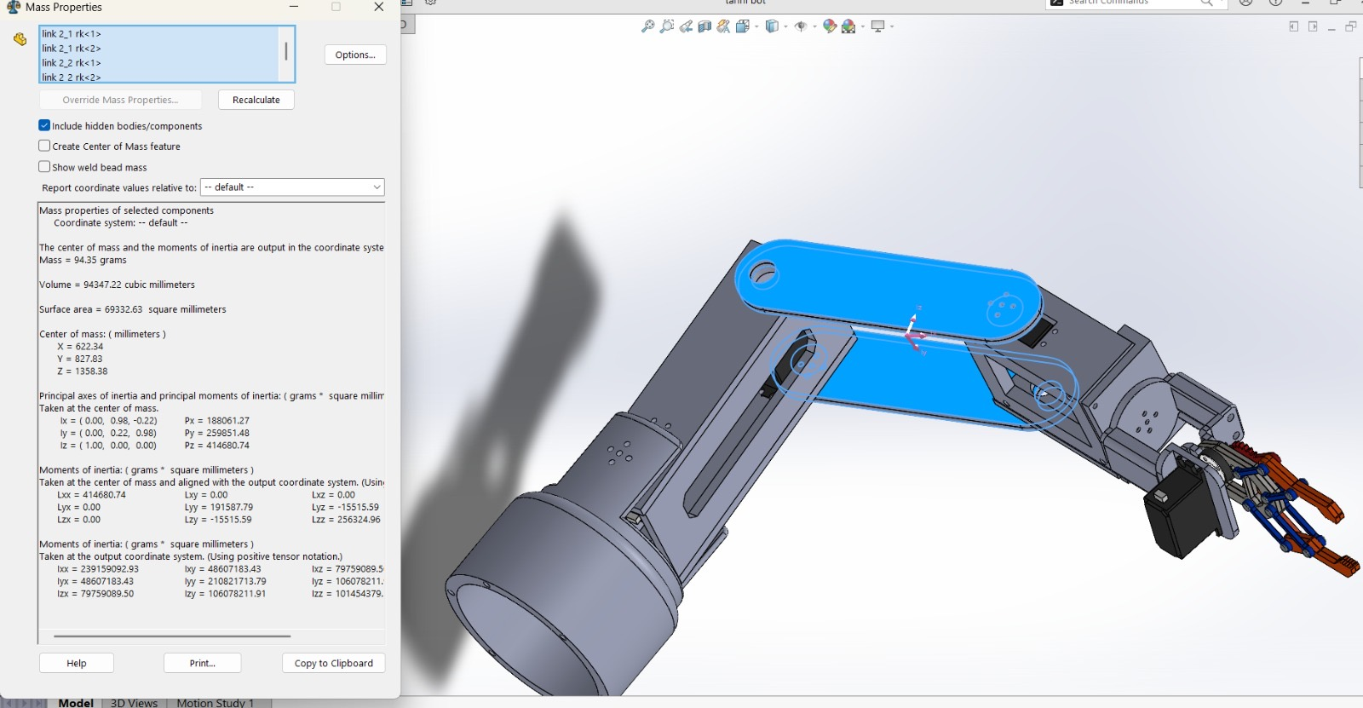
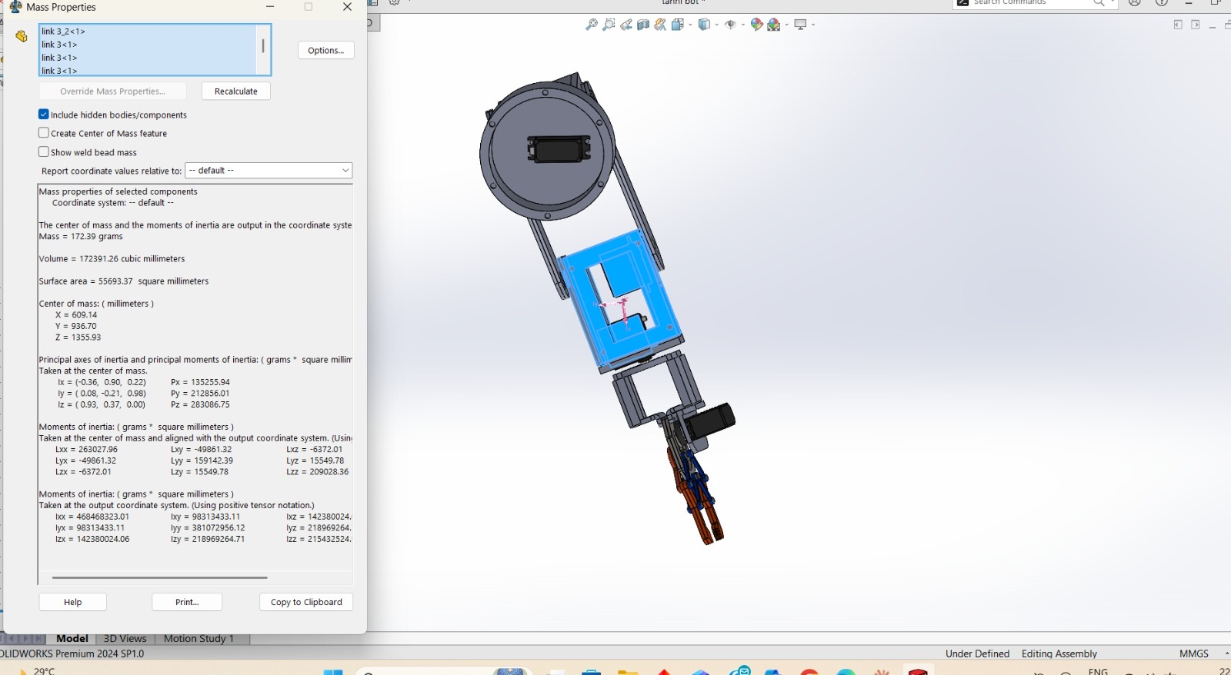
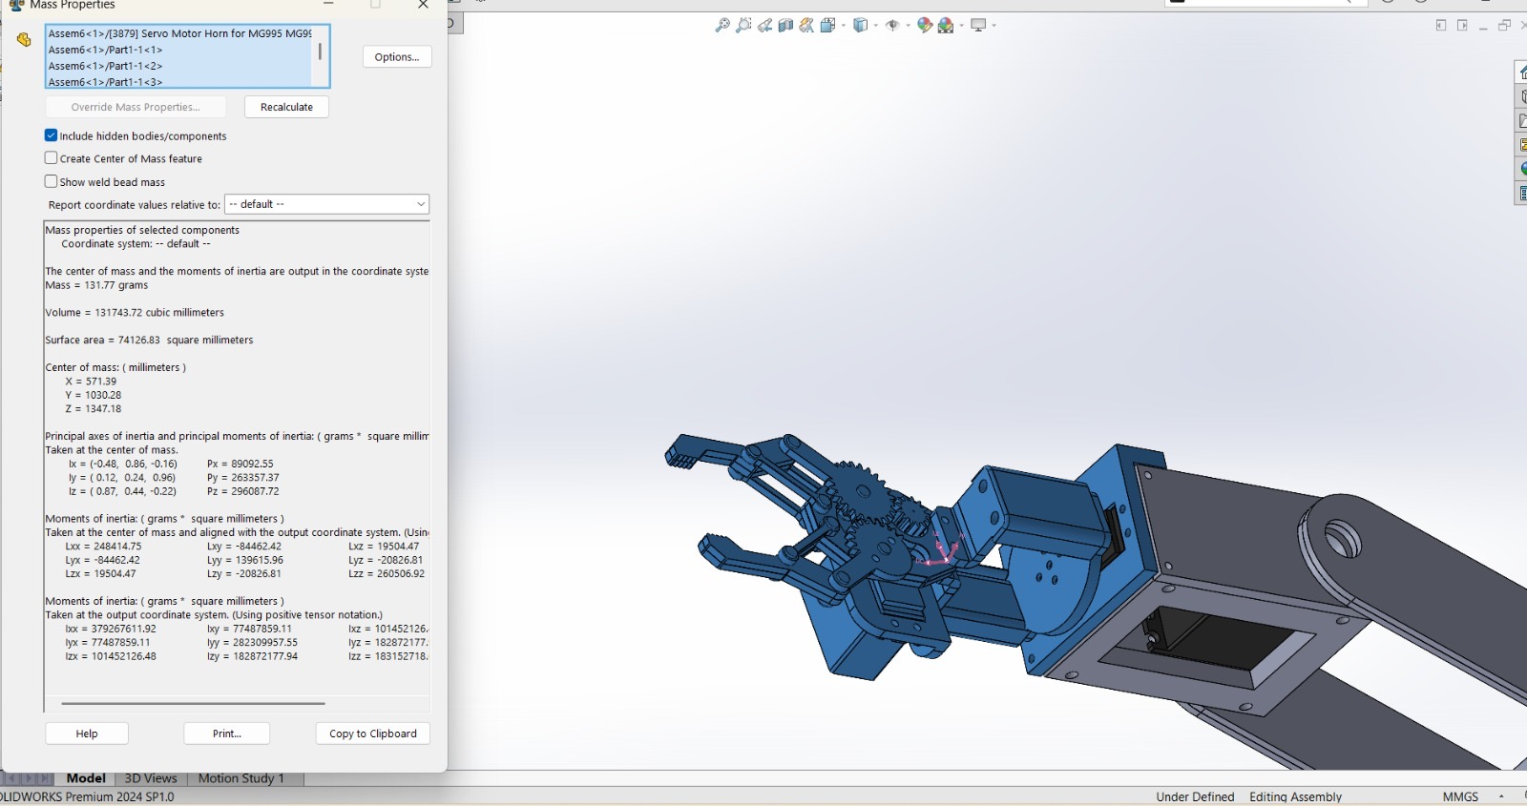
05 — MECHANICAL DESIGN
Assembly Segment Mass Breakdown
Total Assembly: 1044.39 g | 10.245 N | 90.5% of mass accounted by photographed segments
Base Assembly
359.11 g
Link 1
187.62 g
Link 2
94.35 g
Link 3
172.39 g
Gripper
131.77 g

Slide 9
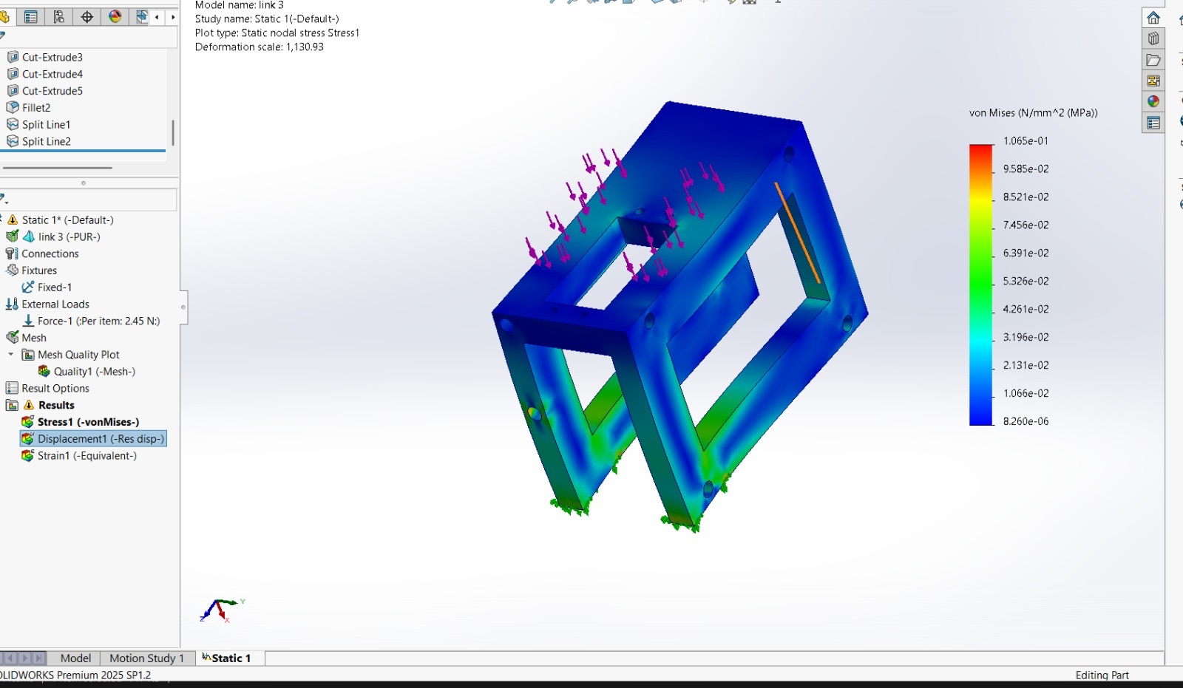
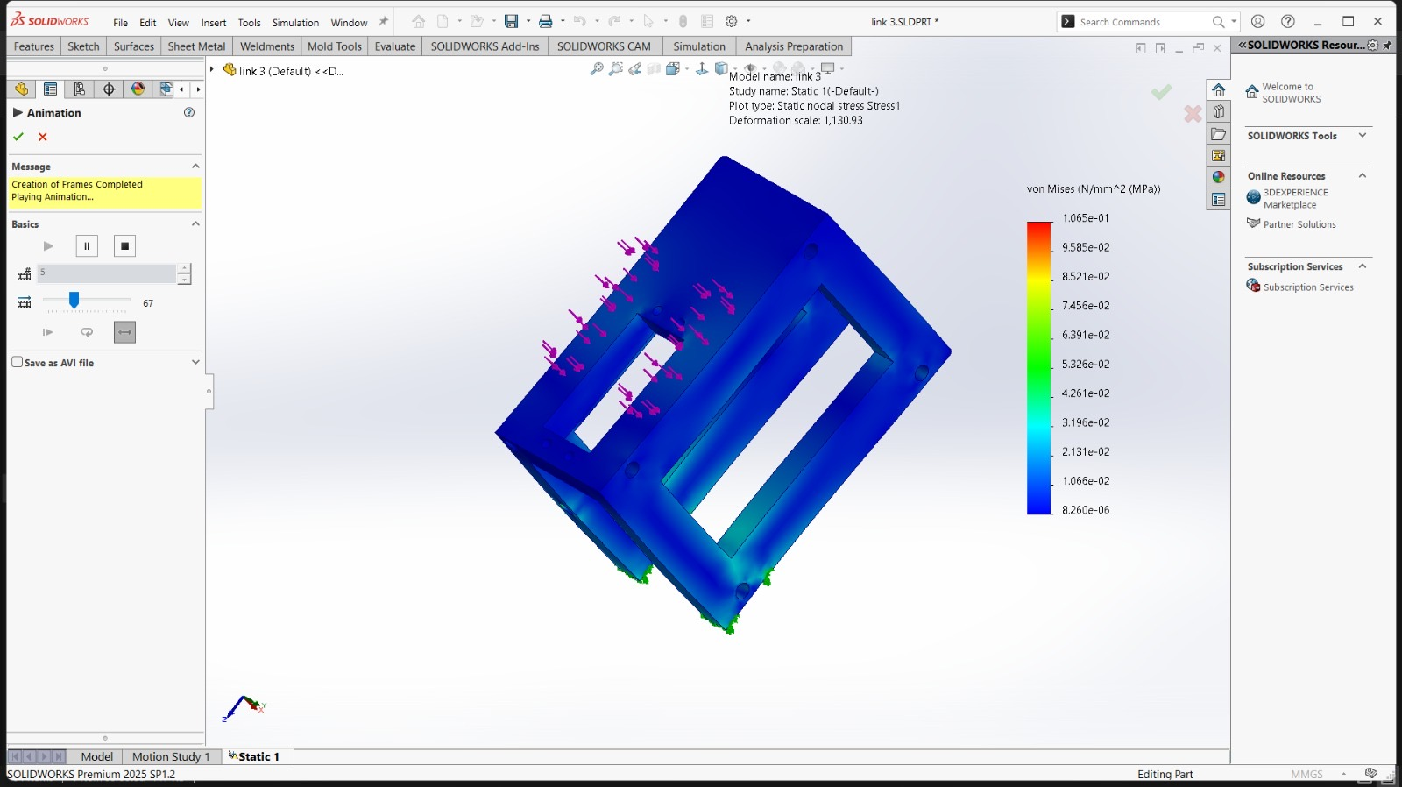
06 — FEA STRUCTURAL ANALYSIS
FEA — Link 3 (PUR Material)
Material: PUR (Polyurethane)
Load Applied: 2.45 N per item
Max von Mises: 0.1065 MPa
Min von Mises: 8.26×10⁻⁶ MPa
Result: Well within yield limit
Deformation Scale: 1,130.93 — Stress distribution is predominantly low (blue), confirming design safety

Slide 10
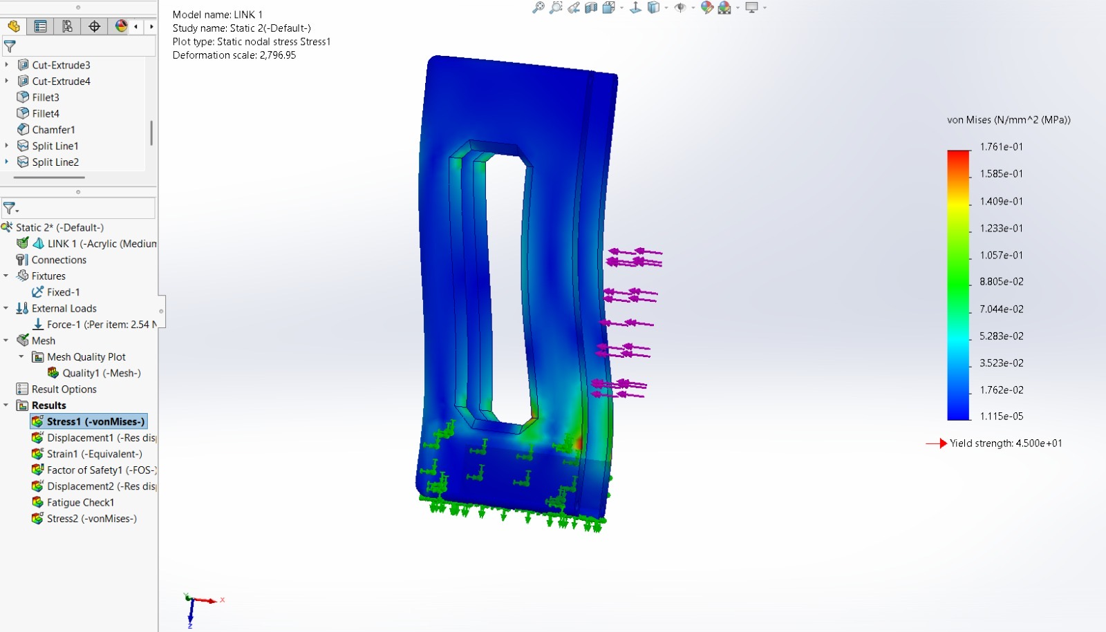
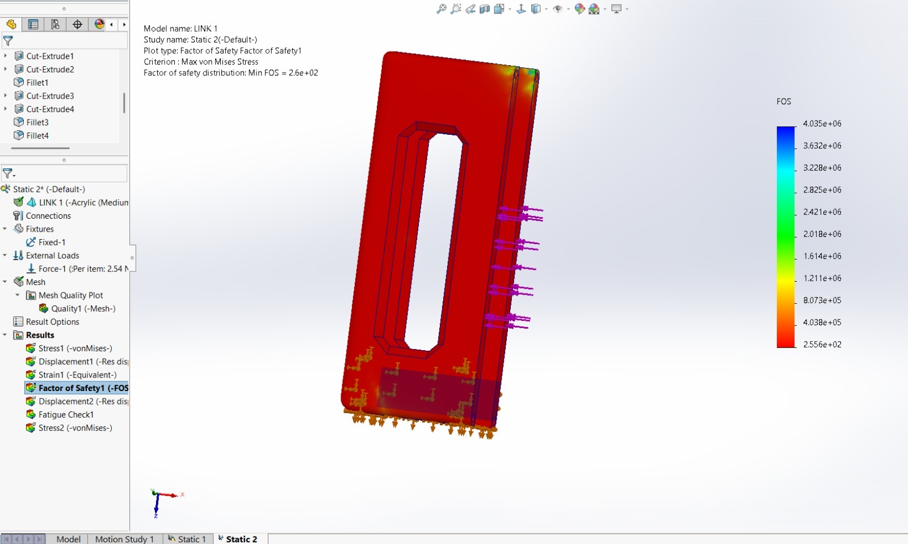
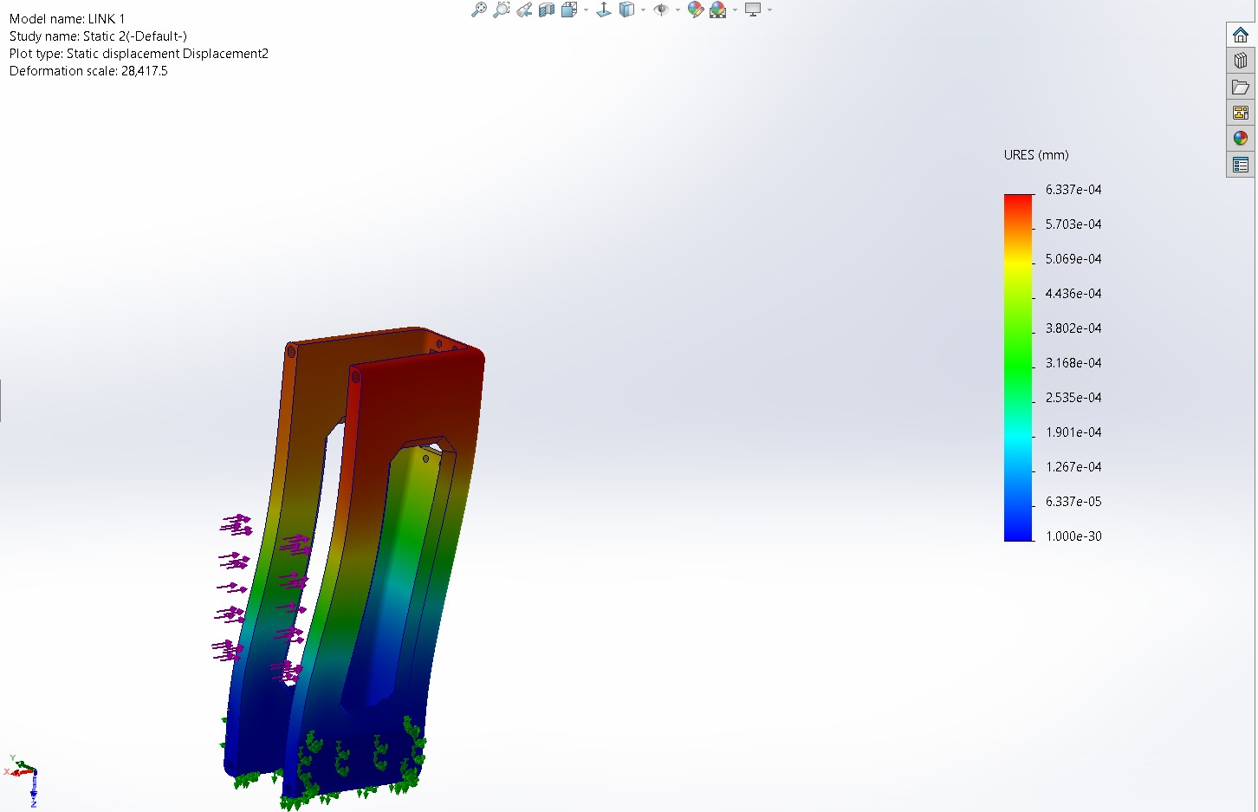
06 — FEA STRUCTURAL ANALYSIS
FEA — Link 1 (Acrylic Material)
Load: 2.54 N | Material: Acrylic (Medium Impact) | Yield Strength: 45 MPa | Max Stress: 0.176 MPa | Min FOS: 260 | Status: SAFE ✓
Von Mises Stress
(Static nodal)
Factor of Safety
Min FOS = 260
Displacement
URES (mm)

Slide 11
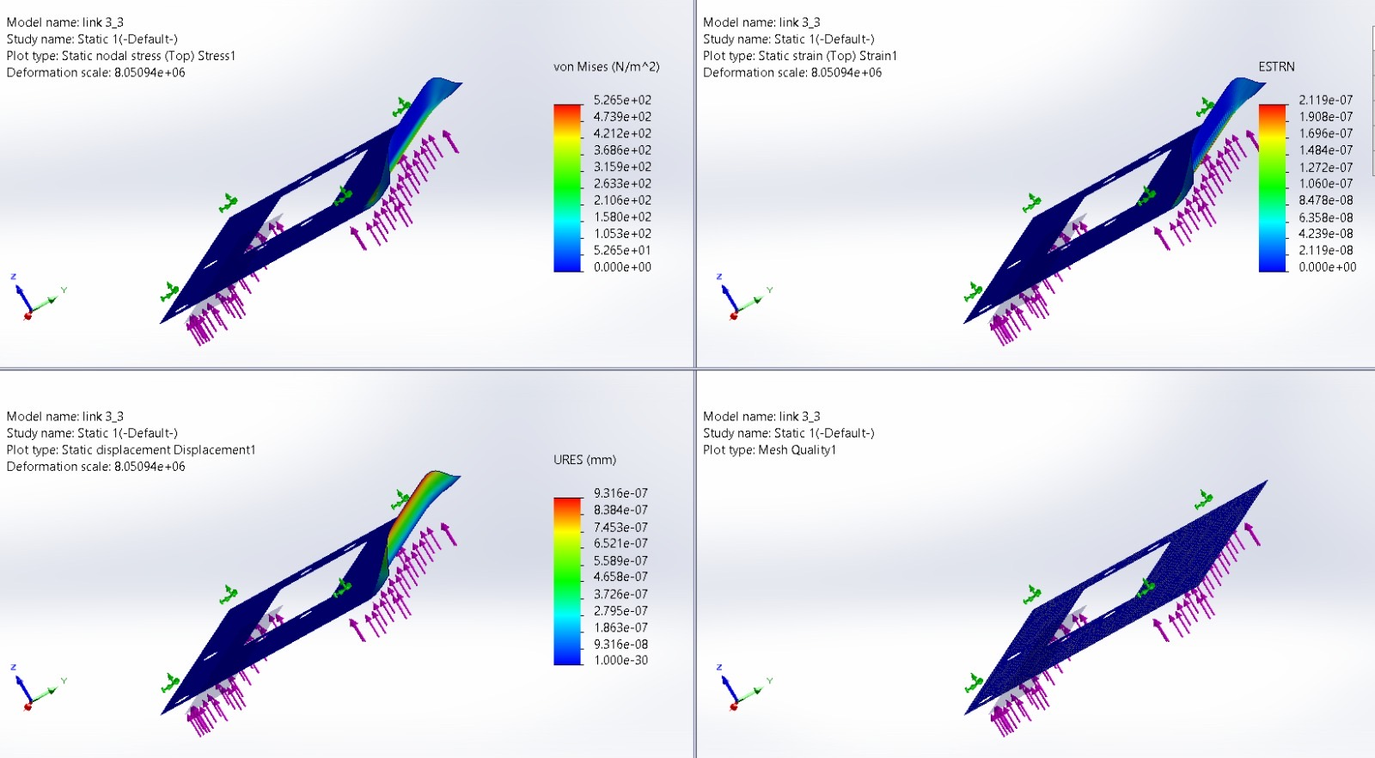
06 — FEA STRUCTURAL ANALYSIS
FEA — Link 3_3 Shell Analysis
4-panel result view: Von Mises Stress | Equivalent Strain | Resultant Displacement | Mesh Quality — All results indicate negligible deformation (sub-micron range)

Slide 12
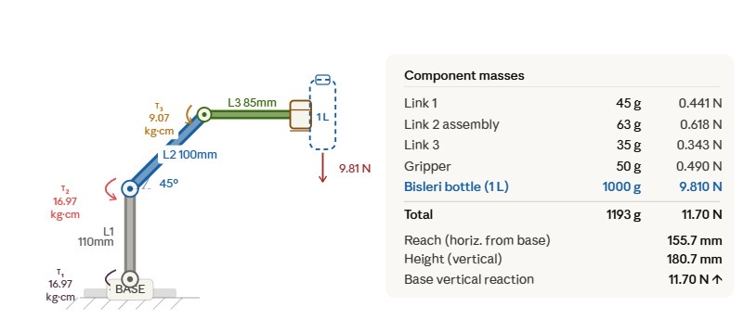
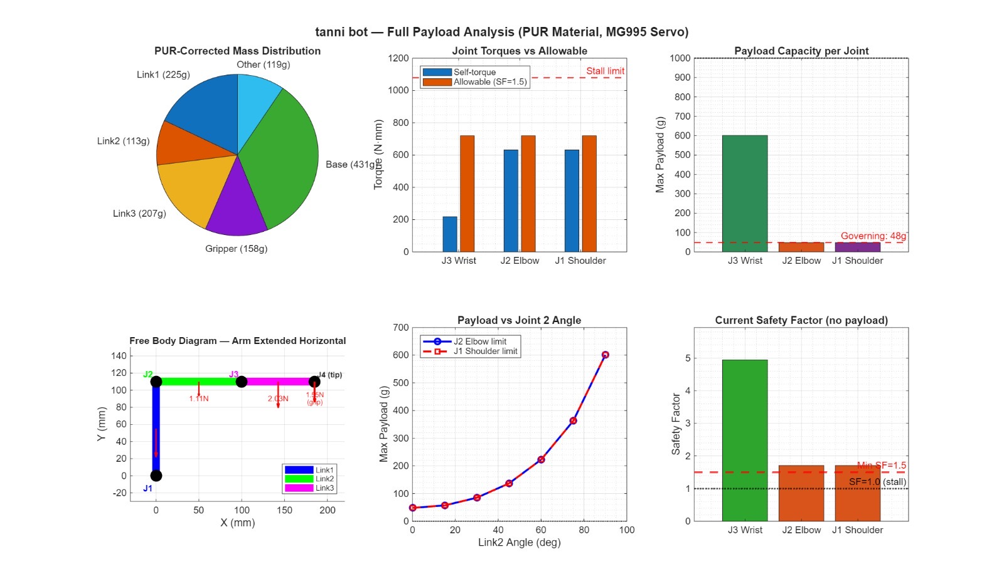
07 — TORQUE & PAYLOAD ANALYSIS
Joint Torque & Payload Capacity
Joint | Self-Torque | Allowable (SF=1.5) | Payload
J1 Shoulder | 620 N·mm | 700 N·mm | 48 g
J2 Elbow | 620 N·mm | 700 N·mm | 55 g
J3 Wrist | 207 N·mm | 700 N·mm | 600 g
⚠ Governing constraint: J1 Shoulder & J2 Elbow limit payload to ~48 g at full horizontal reach

Slide 13
08 — CIRCUIT DIAGRAM
Arduino UNO Control System
ARDUINO UNO
ATmega328P
PCA9685
16-ch I2C
Servo Driver
6V / 5A
DC Power
Supply
I2C (SDA/SCL)
5V / GND
D3
D5
D6
MG995
Servos
×6
D9
D10
Servo 1
Base Yaw
D11
Servo 4
Wrist Pitch
PC / Serial
USB / Serial
Servo 2
Shoulder
Servo 5
Wrist Roll
Servo 3
Elbow
Servo 6
Gripper
Signal flow: PC → Arduino UNO → PCA9685 (I2C) → MG995 Servos (PWM) | Power: 6V @ 5A → Servos & Driver

Slide 14
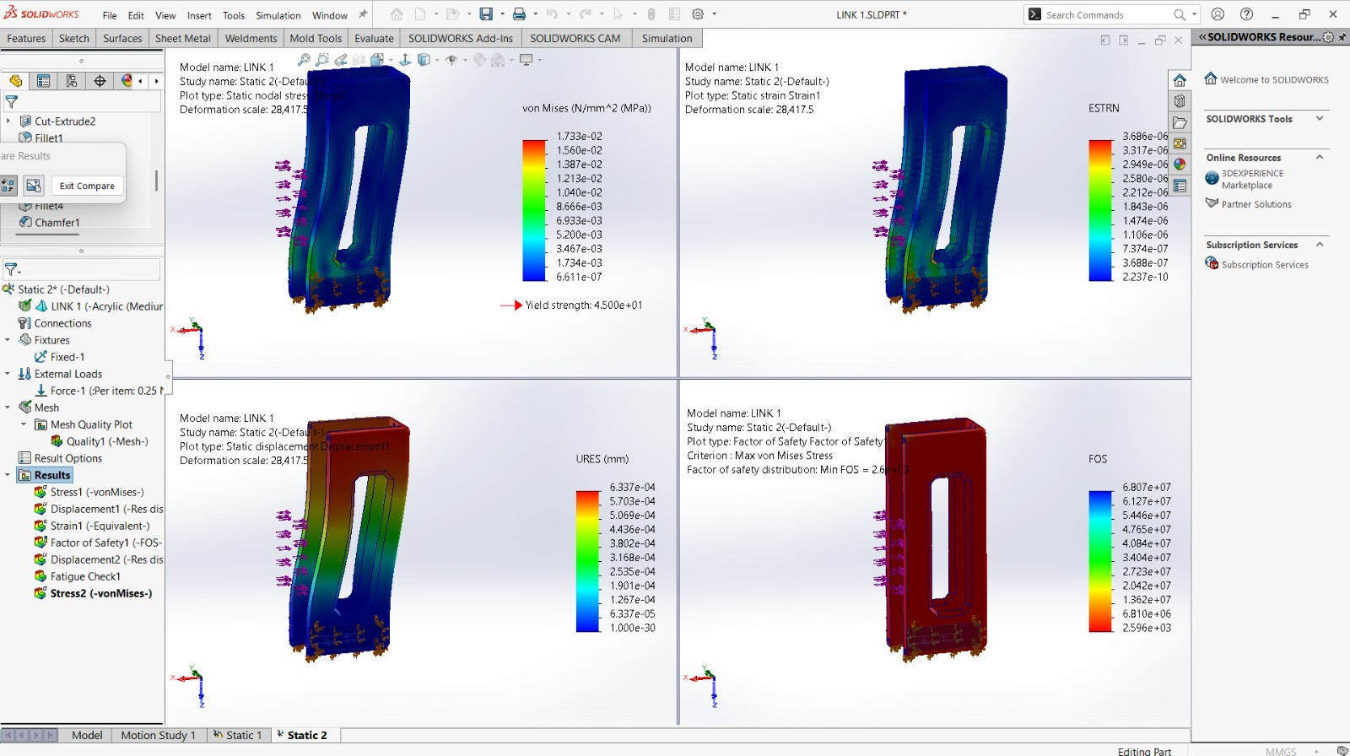
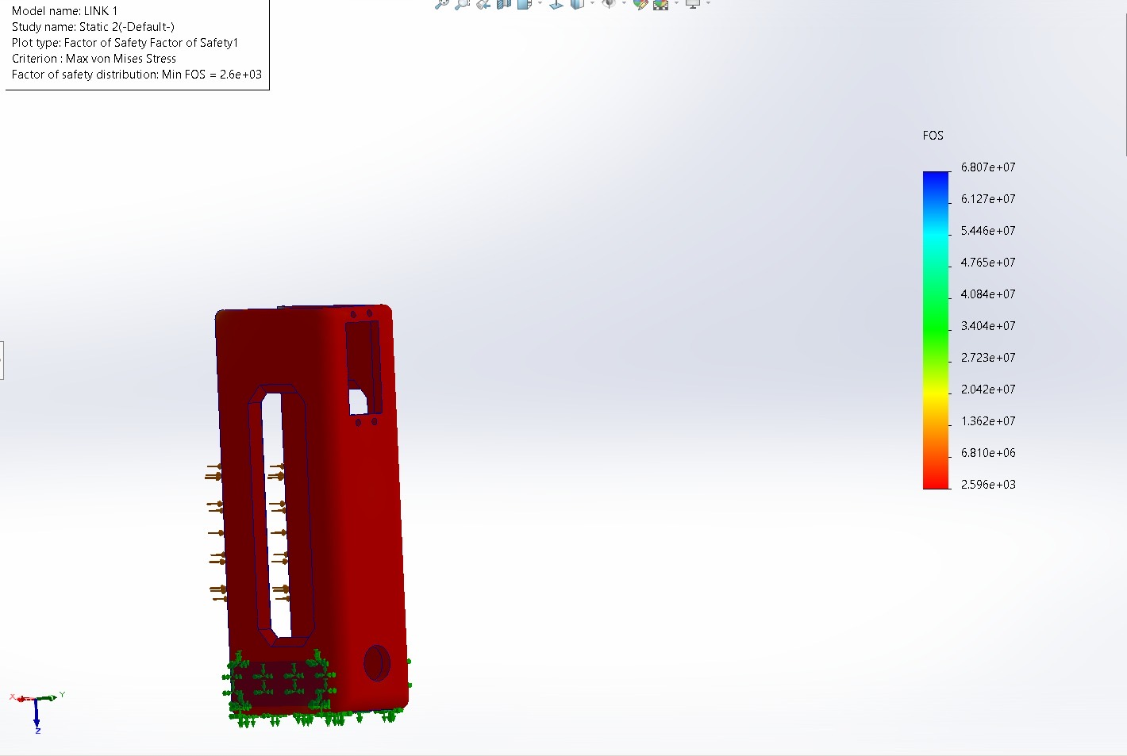
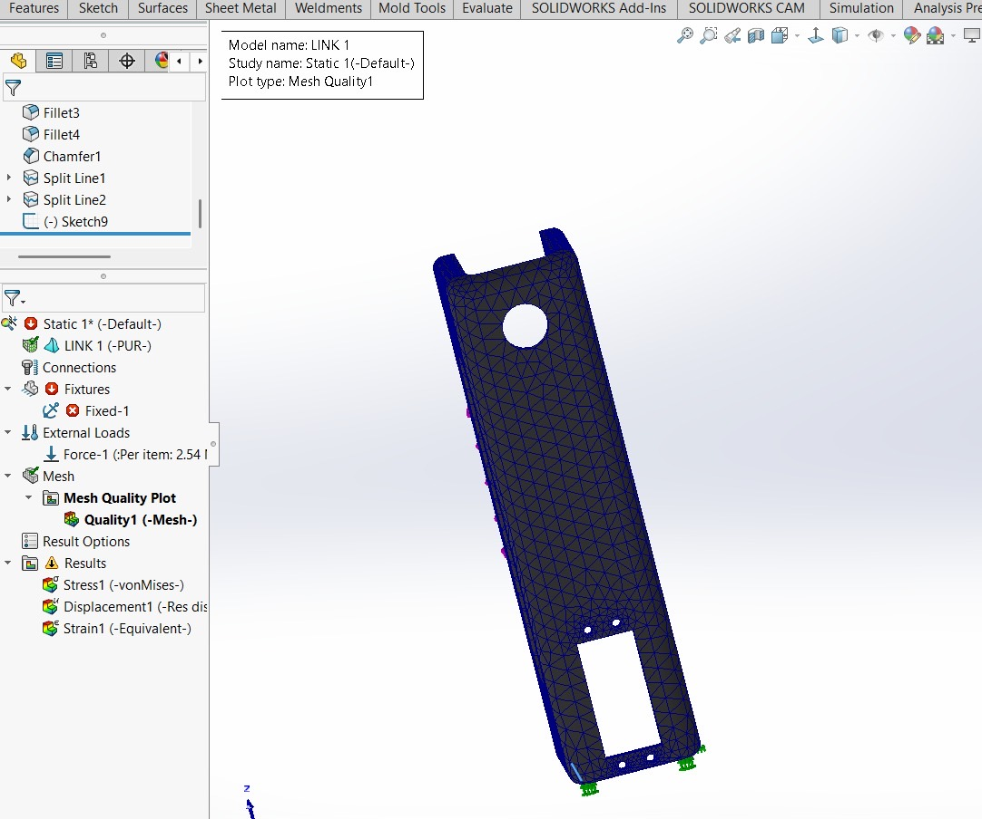
09 — OUTPUT & RESULTS
Simulation & Physical Results
Max Stress (Link 1) | 0.176 MPa | Yield: 45 MPa — SAFE
Min FOS (Link 1) | 260× | Far above SF=1.5 target
Max Stress (Link 3) | 0.107 MPa | PUR well within limits
Link 3_3 Displacement | <1 μm | Negligible deformation
Total Assembly Mass | 1044.39 g | SolidWorks verified
Governing Payload | ~48 g | Limited by J1/J2 torque

Slide 15
10 — APPLICATIONS
Applications & Future Scope
🏭
🔬
🏥
Industrial Automation
Research & Education
Medical Assistance
Pick-and-place in assembly lines, repetitive material handling, conveyor sorting.
Teaching kinematics, robotics programming, and FEA validation in academic labs.
Rehabilitative therapy arms, surgical assistance, pharmaceutical pick-and-place.
🌐
🤖
🔧
Remote Operations
Collaborative Robotics
Rapid Prototyping
Tele-operation in hazardous environments (nuclear, chemical, deep sea).
Human-robot collaboration on light assembly tasks and service counters.
Low-cost platform for testing gripper designs, sensors, and control algorithms.

Slide 16
Thank You
TANNI BOT — 5-DOF Articulated Robotic Arm
✓ 5 DOF | 6× MG995 Servo Motors
✓ Total Mass: 1044.39 g | Verified by SolidWorks
✓ FEA: Min FOS = 260 | Stress well within limits
✓ Arduino UNO + PCA9685 control system
✓ 3D printed PUR & Acrylic structural links
Department of Mechanical Engineering | 2025–26

